Slide 1
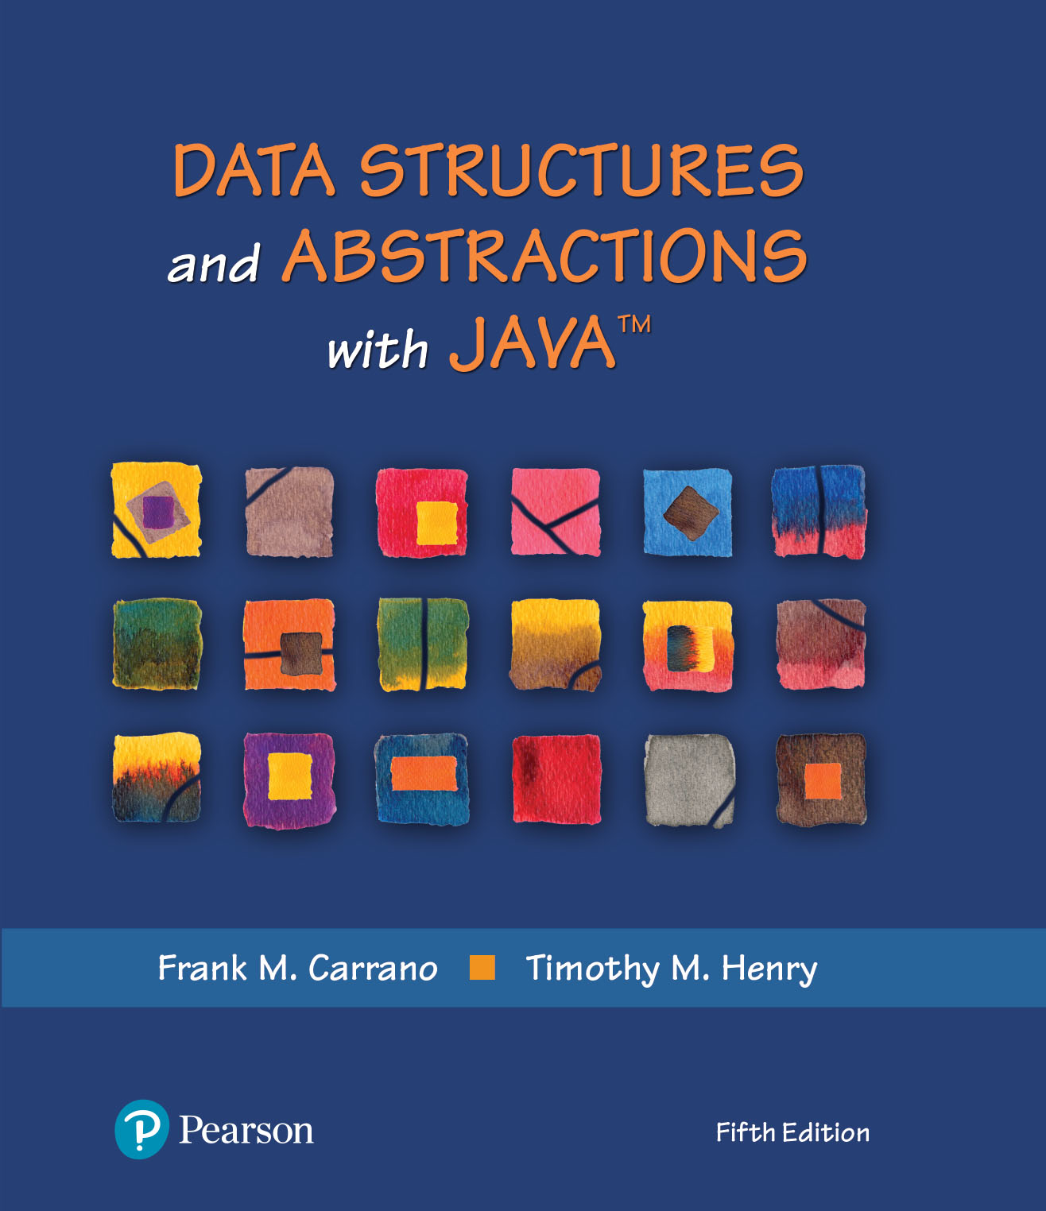
Data Structures and Abstractions with Java™
5th Edition
Module 12 – Searching and Dictionaries
Including:
Chapter 19 – Searching
Chapter 20 – Dictionaries
Chapter 21 – Dictionary Implementations

Slide 2
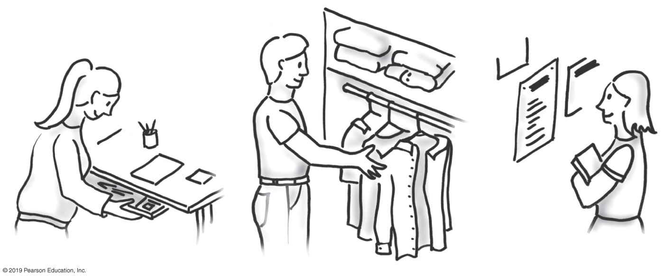
The Problem
FIGURE 19-1 Searching is an everyday occurrence

Slide 3
Iterative Sequential Search of an Unsorted Array
public static <T> boolean inArray(T[] anArray, T anEntry)
{
boolean found = false;
int index = 0;
while (!found && (index < anArray.length))
{
if (anEntry.equals(anArray[index]))
found = true;
index++;
} // end while
return found;
} // end inArray
Using a loop to search for a specific valued entry.

Slide 4
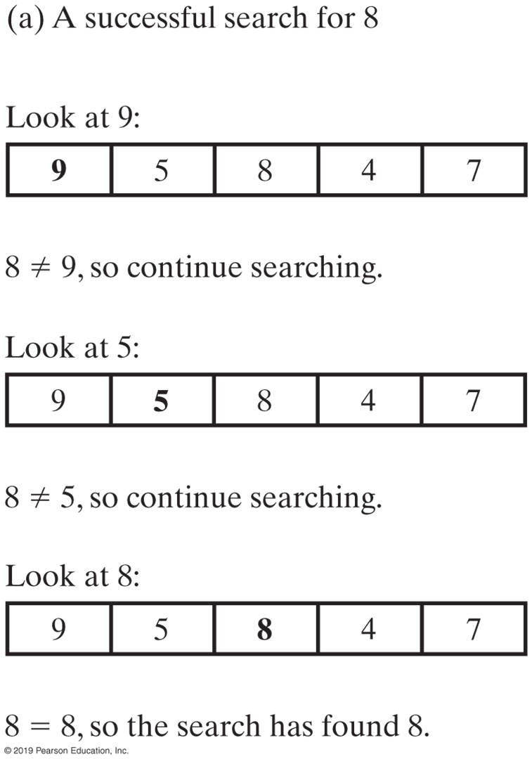
Iterative Sequential Search of an Unsorted Array
FIGURE 19-2a An iterative sequential search of an array

Slide 5
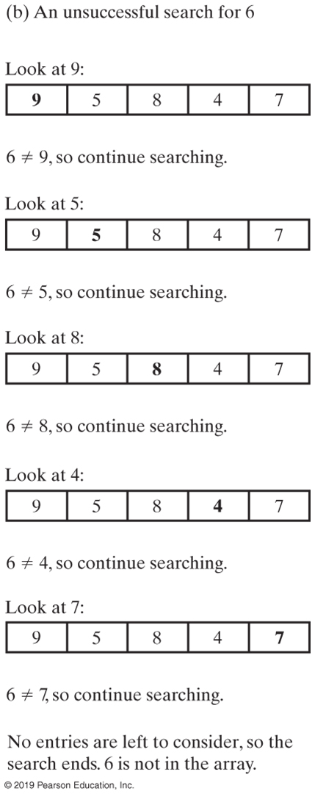
Iterative Sequential Search of an Unsorted Array
FIGURE 19-2b An iterative sequential search of an array

Slide 6
Recursive Sequential Search of an Unsorted Array
Algorithm to search a[first] through a[last] for desiredItem
if (there are no elements to search)
return false
else if (desiredItem equals a[first])
return true else
return the result of searching a[first + 1] through a[last]
Pseudocode of the logic of our recursive algorithm.

Slide 7
Recursive Sequential Search of an Unsorted Array
/** Searches an array for anEntry. */
public static <T> boolean inArray(T[] anArray, T anEntry)
{
return search(anArray, 0, anArray.length - 1, anEntry);
} // end inArray
// Searches anArray[first] through anArray[last] for desiredItem.
// first >= 0 and < anArray.length.
// last >= 0 and < anArray.length.
private static <T> boolean search(T[] anArray, int first, int last, T desiredItem)
{
boolean found;
if (first > last)
found = false; // No elements to search
else if (desiredItem.equals(anArray[first]))
found = true;
else
found = search(anArray, first + 1, last, desiredItem);
return found;
} // end search
Method that implements this algorithm will need parameters first and last.

Slide 8
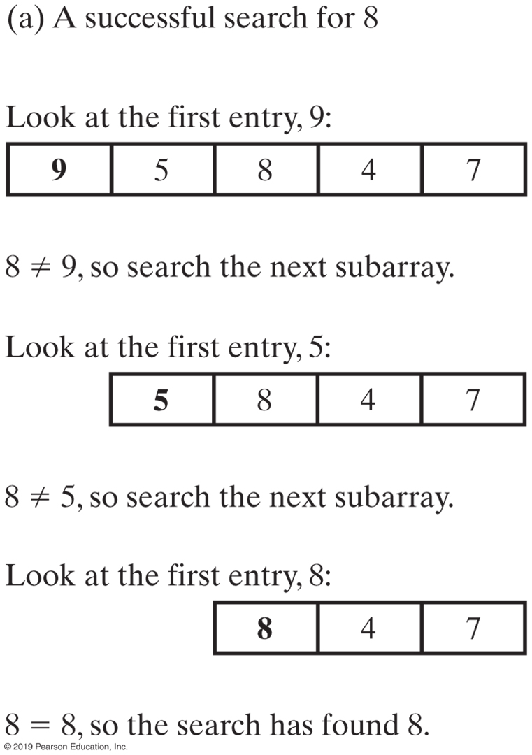
Recursive Sequential Search of an Unsorted Array
FIGURE 19-3a A recursive sequential search of an array

Slide 9
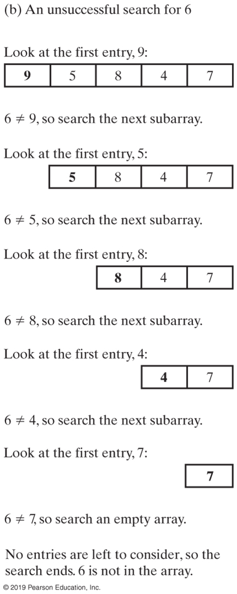
Recursive Sequential Search of an Unsorted Array
FIGURE 19-3b A recursive sequential search of an array

Slide 10
Efficiency of a Sequential Search of an Array
The time efficiency of a sequential search of an array.
Best case O(1)
Worst case: O(n)
Average case: O(n)

Slide 11

Sequential Search of a Sorted Array
FIGURE 19-4 Coins sorted by their mint dates

Slide 12

Binary Search of a Sorted Array
FIGURE 19-5 Ignoring one half of the data when the data is sorted

Slide 13
Binary Search of a Sorted Array
Algorithm to search a[0] through a[n − 1] for desiredItem
mid = approximate midpoint between 0 and n – 1
if (desiredItem equals a[mid])
return true
else if (desiredItem < a[mid])
return the result of searching a[0] through a[mid – 1]
else if (desiredItem > a[mid])
return the result of searching a[mid + 1] through a[n – 1]
First draft of an algorithm for a binary search of an array

Slide 14
Binary Search of a Sorted Array
Algorithm binarySearch(a, first, last, desiredItem)
mid = approximate midpoint between first and last
if (desiredItem equals a[mid])
return true
else if (desiredItem < a[mid])
return binarySearch(a, first, mid − 1, desiredItem)
else if (desiredItem > a[mid])
return binarySearch(a, mid + 1, last, desiredItem)
Revision of binary search algorithm as method

Slide 15
Binary Search of a Sorted Array
Algorithm binarySearch(a, first, last, desiredItem)
mid = (first + last) / 2 // Approximate midpoint
if (first > last)
return false
else if (desiredItem equals a[mid])
return true
else if (desiredItem < a[mid])
return binarySearch(a, first, mid − 1, desiredItem)
else // desiredItem > a[mid]
return binarySearch(a, mid + 1, last, desiredItem)
Refine the logic a bit, get a more complete algorithm

Slide 16
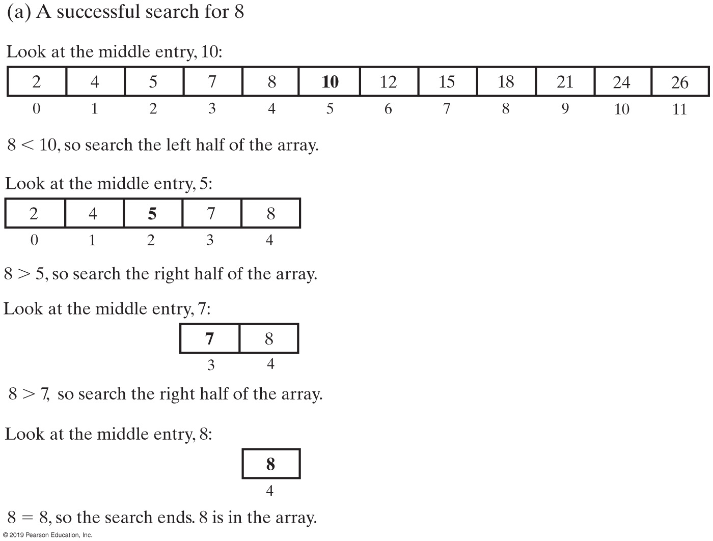
Binary Search of a Sorted Array
FIGURE 19-6a A recursive binary search of a sorted array

Slide 17
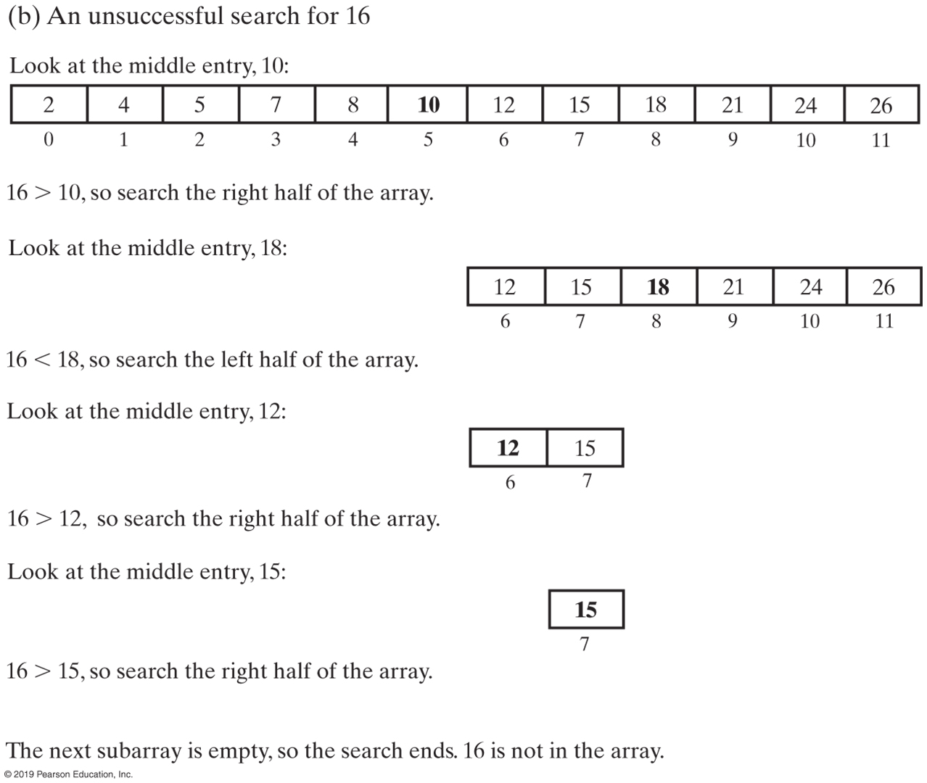
Binary Search of a Sorted Array
FIGURE 19-6b A recursive binary search of a sorted array

Slide 18
Binary Search of a Sorted Array
private static <T extends Comparable<? super T>>
boolean binarySearch(T[] anArray, int first, int last, T desiredItem)
{
boolean found;
int mid = first + (last - first) / 2;
if (first > last)
found = false;
else if (desiredItem.equals(anArray[mid]))
found = true;
else if (desiredItem.compareTo(anArray[mid]) < 0)
found = binarySearch(anArray, first, mid - 1, desiredItem);
else
found = binarySearch(anArray, mid + 1, last, desiredItem);
return found;
} // end binarySearch
public static <T extends Comparable<? super T>> boolean inArray(T anEntry)
{
return binarySearch(anArray, 0, anArray.length - 1, anEntry);
} // end inArray
Implementation of the method binarySearch

Slide 19
Java Class Library: The Method binarySearch
/** Searches an entire array for a given item.
@param array An array sorted in ascending order.
@param desiredItem The item to be found in the array.
@return Index of the array entry that equals desiredItem;
otherwise returns –belongsAt – 1, where belongsAt is
the index of the array element that should contain desiredItem. */
public static int binarySearch(type[] array, type desiredItem);
Static method binarySearch specification

Slide 20
Efficiency of a Binary Search of an Array
The time efficiency of a binary search of an array
Best case: O(1)
Worst case: O(log n)
Average case: O(log n)

Slide 21

Iterative Sequential Search of an Unsorted Chain
FIGURE 19-7 A chain of linked nodes that contain the entries in a list

Slide 22
Iterative Sequential Search of an Unsorted Chain
public boolean contains(T anEntry)
{
boolean found = false;
Node currentNode = firstNode;
while (!found && (currentNode != null))
{
if (anEntry.equals(currentNode.getData()))
found = true;
else
currentNode = currentNode.getNextNode();
} // end while
return found;
} // end contains
Implementation of iterative search in contains

Slide 23
Recursive Sequential Search of an Unsorted Chain
private boolean search(Node currentNode, T desiredItem)
{
boolean found;
if (currentNode == null)
found = false;
else if (desiredItem.equals(currentNode.getData()))
found = true;
else
found = search(currentNode.getNextNode(), desiredItem);
return found;
} // end search
public boolean contains(T anEntry)
{
return search(firstNode, anEntry);
} // end contains
Implementation of recursive search in search

Slide 24
Iterative Sequential Search of a Sorted Chain
public boolean contains(T anEntry)
{
Node currentNode = firstNode;
while ( (currentNode != null) &&
(anEntry.compareTo(currentNode.getData()) > 0) )
{
currentNode = currentNode.getNextNode();
} // end while
return (currentNode != null) &&
anEntry.equals(currentNode.getData());
} // end contains
Implementation of iterative search in contains

Slide 25
Binary Search of a Sorted Chain
First find middle of the chain:
You must traverse the whole chain
Then traverse one of the halves to find the middle of that half
Conclusion
Hard to implement
Less efficient than sequential search

Slide 26
Choosing between Iterative Search and Recursive Search
Operation | Best Case | Average Case | Linked
Sequential Search (unsorted data) | O(1) | O(n) | O(n)
Sequential Search (sorted data) | O(1) | O(n) | O(n)
Binary Search (sorted array) | O(1) | O(log n) | O(log n)
FIGURE 19-8 The time efficiency of searching, expressed in Big Oh notation

Slide 27
Choosing between Iterative Search and Recursive Search
Iterative Searches
Can save some time and space
Recursive Searches
Will not require much additional space for the recursive calls
Coding binary search recursively is easier

Slide 28

Dictionaries
When you want to look up …
The meaning of a word
An address
A phone number
A contact on your phone
These can be implemented in an ADT Dictionary

Slide 29
Specifications for the ADT Dictionary
Synonyms for ADT Dictionary
Map
Table
Associative array
An entry in the dictionary contains
Keyword, search key
Value

Slide 30
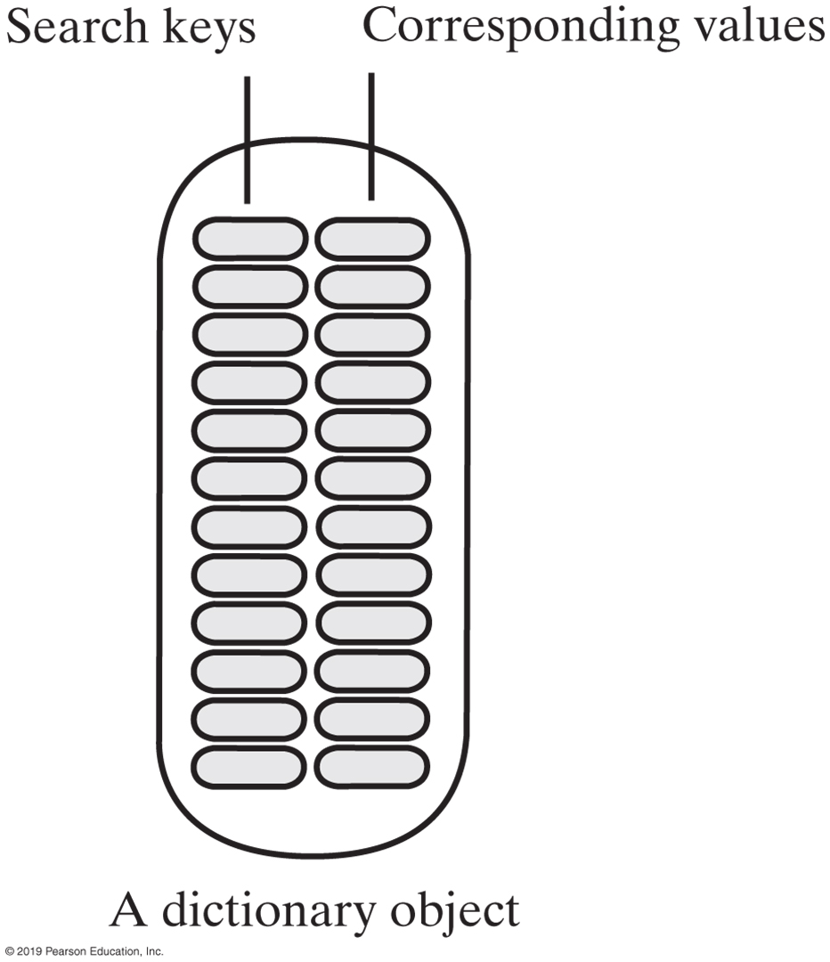
Specifications for the ADT Dictionary
Dictionary Data
Collection of pairs (k, v) of objects k and v,
k is the search key
v is the corresponding value
Number of pairs in the collection
FIGURE 20-2 An instance of the ADT dictionary has search keys paired with corresponding values

Slide 31
Specifications for the ADT Dictionary
Operations
add(key, value)
remove(key)
getValue(key)
contains(key)
getKeyIterator()
getValueIterator()
isEmpty()
getSize()
clear()

Slide 32
A Java Interface for ADT Dictionary (Part 1)
/** An interface for a dictionary with distinct search keys.
Search keys and associated values are not null. */
public interface DictionaryInterface<K, V>
{
/** Adds a new entry to this dictionary. If the given search key already
exists in the dictionary, replaces the corresponding value.
@param key An object search key of the new entry.
@param value An object associated with the search key.
@return Either null if the new entry was added to the dictionary
or the value that was associated with key if that value
was replaced. */
public V add(K key, V value);
/** Removes a specific entry from this dictionary.
@param key An object search key of the entry to be removed.
@return Either the value that was associated with the search key
or null if no such object exists. */
public V remove(K key);
/** Retrieves from this dictionary the value associated with a given
search key.
@param key An object search key of the entry to be retrieved.
@return Either the value that is associated with the search key
or null if no such object exists. */
public V getValue(K key);
LISTING 20-1 An interface for the ADT dictionary

Slide 33
A Java Interface for ADT Dictionary (Part 2)
/** Sees whether a specific entry is in this dictionary.
@param key An object search key of the desired entry.
@return True if key is associated with an entry in the dictionary. */
public boolean contains(K key);
/** Creates an iterator that traverses all search keys in this dictionary.
@return An iterator that provides sequential access to the search
keys in the dictionary. */
public Iterator<K> getKeyIterator();
/** Creates an iterator that traverses all values in this dictionary.
@return An iterator that provides sequential access to the values
in this dictionary. */
public Iterator<V> getValueIterator();
/** Sees whether this dictionary is empty.
@return True if the dictionary is empty. */
public boolean isEmpty();
/** Gets the size of this dictionary.
@return The number of entries (key-value pairs) currently
in the dictionary. */
public int getSize();
/** Removes all entries from this dictionary. */
public void clear();
} // end DictionaryInterface
LISTING 20-1 An interface for the ADT dictionary

Slide 34
Dictionary Iterators
Options for dictionary iterators
Can use each of these iterators either separately or together to traverse:
All search keys in a dictionary without traversing values
All values without traversing search keys
All search keys and all values in parallel
Iterator<String> keyIterator = dataBase.getKeyIterator();
Iterator<Student> valueIterator = dataBase.getValueIterator();

Slide 35
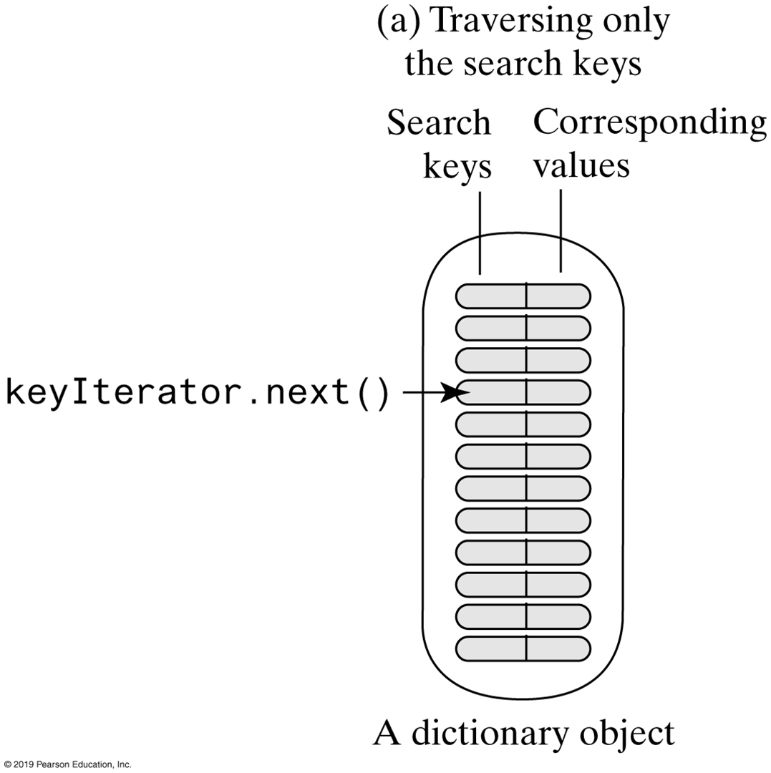
Dictionary Iterators
FIGURE 20-3a Traversing a dictionary’s keys separately

Slide 36
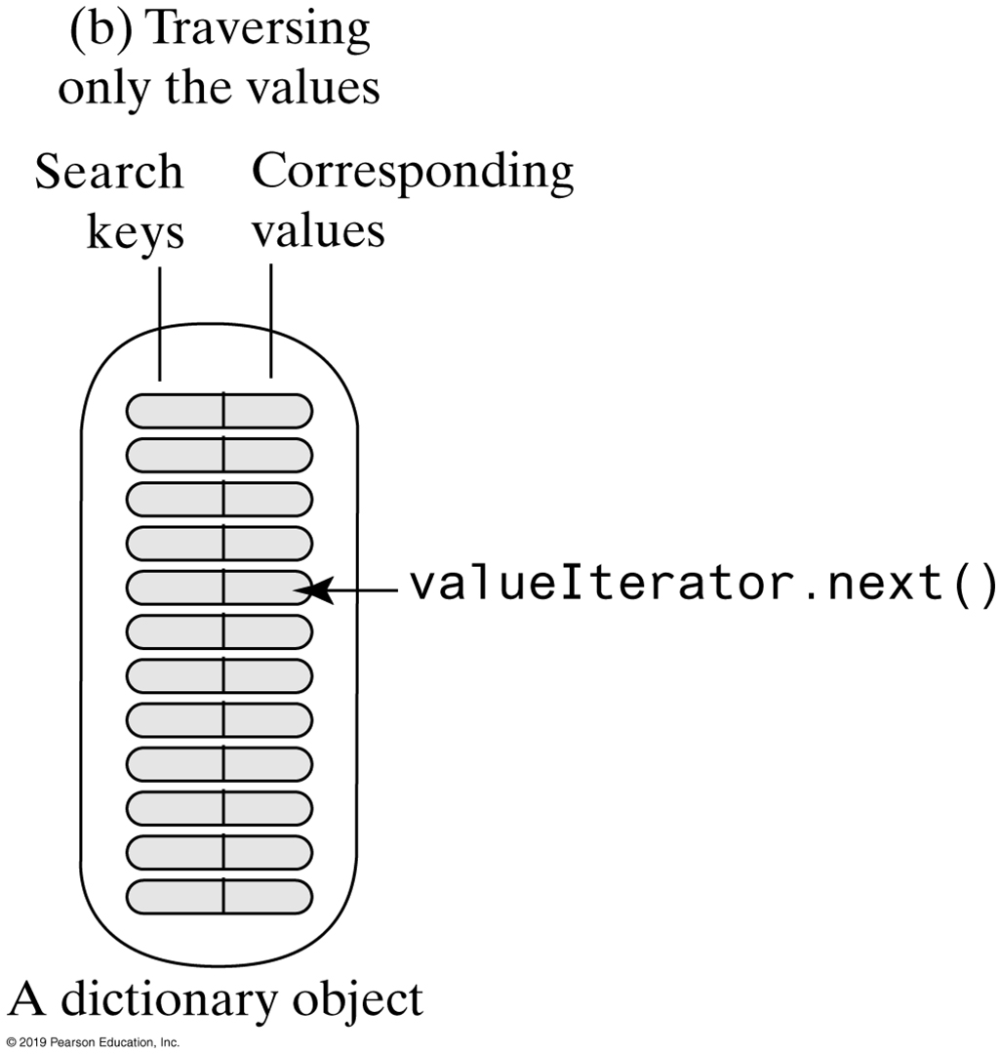
Dictionary Iterators
FIGURE 20-3a Traversing a dictionary’s values separately

Slide 37
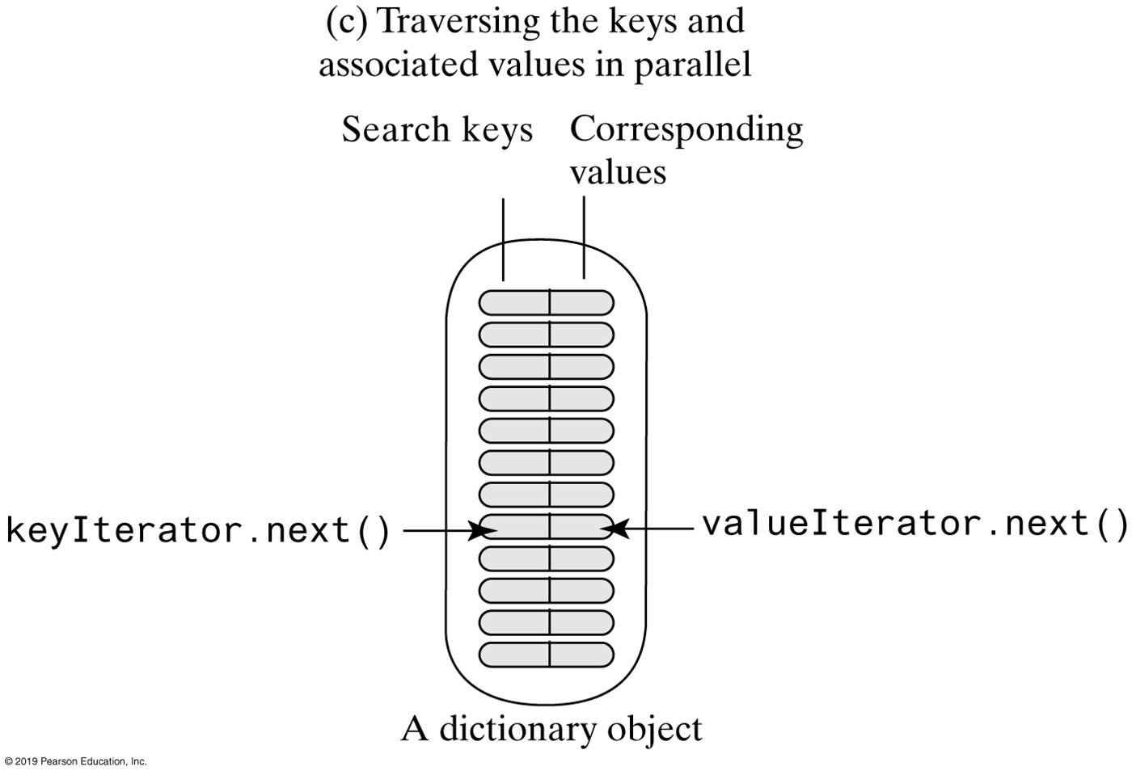
Dictionary Iterators
FIGURE 20-3a Two iterators that traverse a dictionary’s keys and values in parallel

Slide 38
Using a Dictionary
TelephoneDirectory
phoneBook
readFile(data) getPhoneNUmber(name)
1
Dictionary
*
Name
1
*
*
*
String
FIGURE 20-4 A class diagram for a telephone directory

Slide 39
A Directory of Telephone Numbers (Part 1)
/** A driver that demonstrates the class TelephoneDirectory. */
public class Driver
{
private static final Name INPUT_ERROR = new Name("error", "error");
private static final Name QUIT = new Name("quit", "quit");
public static void main(String[] args)
{
TelephoneDirectory directory = new TelephoneDirectory();
String fileName = "data.txt"; // Or file name could be read
try
{
Scanner data = new Scanner(new File(fileName));
directory.readFile(data);
}
catch (FileNotFoundException e)
{
System.out.println("File not found: " + e.getMessage());
}
Name nextName = getName(); // Get name for search from user
LISTING 20-2 A client of the class TelephoneDirectory

Slide 40
A Directory of Telephone Numbers (Part 2)
while (!nextName.equals(QUIT))
{
if (nextName.equals(INPUT_ERROR))
System.out.println("Error in entering name. Try again.");
else
{
String phoneNumber = directory.getPhoneNumber(nextName);
if (phoneNumber == null)
System.out.println(nextName + " is not in the directory.");
else
System.out.println("The phone number for " + nextName +
" is " + phoneNumber);
} // end if
nextName = getName();
} // end while
System.out.println("Bye!");
} // end main
LISTING 20-2 A client of the class TelephoneDirectory

Slide 41
A Directory of Telephone Numbers (Part 3)
// Returns either the name read from user, INPUT_ERROR, or QUIT.
private static Name getName()
{
Name result = null;
Scanner keyboard = new Scanner(System.in);
System.out.print("Enter first name and last name, " +
"or quit to end: ");
String line = keyboard.nextLine();
if (line.trim().toLowerCase().equals("quit"))
result = QUIT;
else
{
String firstName = null;
String lastName = null;
Scanner scan = new Scanner(line);
LISTING 20-2 A client of the class TelephoneDirectory

Slide 42
A Directory of Telephone Numbers (Part 4)
if (scan.hasNext())
{
firstName = scan.next();
if (scan.hasNext())
lastName = scan.next();
else
result = INPUT_ERROR;
}
else
result = INPUT_ERROR;
if (result == null)
{
// First and last names have been read
result = new Name(firstName, lastName);
} // end if
} // end if
return result;
} // end getName
} // end Driver
LISTING 20-2 A client of the class TelephoneDirectory

Slide 43
A Directory of Telephone Numbers
Program Output
Enter first name and last name or quit to end: Maria Lopez
The phone number for Maria Lopez is 401-555-1234
Enter first name and last name or quit to end: Hunter
Error in entering name. Try again.
Enter first name and last name or quit to end: Hunter Smith
Hunter Smith is not in the directory.
Enter first name and last name or quit to end: quit
Bye!
Sample Testing Output

Slide 44
A Directory of Telephone Numbers (Part 1)
/** A class of telephone directories. */
public class TelephoneDirectory
{ // Sorted dictionary with distinct search keys
private DictionaryInterface<Name, String> phoneBook;
public TelephoneDirectory()
{
phoneBook = new SortedDictionary<>();
} // end default constructor
LISTING 20-3 The class TelephoneDirectory Constructor

Slide 45
A Directory of Telephone Numbers (Part 1)
/** Reads a text file of names and telephone numbers.
@param data A text scanner for the text file of data. */
public void readFile(Scanner data)
{
while (data.hasNext())
{
String firstName = data.next();
String lastName = data.next();
String phoneNumber = data.next();
Name fullName = new Name(firstName, lastName);
phoneBook.add(fullName, phoneNumber);
} // end while
data.close();
} // end readFile
LISTING 20-3 Method readFile of class TelephoneDirectory

Slide 46
A Directory of Telephone Numbers (Part 3)
/** Gets the phone number of a given person. */
public String getPhoneNumber(Name personName)
{
return phoneBook.getValue(personName);
} // end getPhoneNumber
public String getPhoneNumber(String firstName, String lastName)
{
Name fullName = new Name(firstName, lastName);
return phoneBook.getValue(fullName);
} // end getPhoneNumber
} // end TelephoneDirectory
LISTING 20-3 Methods getPhoneNumber of class TelephoneDirectory

Slide 47
The Frequency of Words
/** A driver that demonstrates the class FrequencyCounter. */
public class Driver
{
public static void main(String[] args)
{
FrequencyCounter wordCounter = new FrequencyCounter();
String fileName = "Data.txt"; // Or file name could be read
try
{
Scanner data = new Scanner(new File(fileName));
wordCounter.readFile(data);
}
catch (FileNotFoundException e)
{
System.out.println("File not found: " + e.getMessage());
}
wordCounter.display();
} // end main
} // end Driver
LISTING 20-4 A client of the class FrequencyCounter

Slide 48
The Class FrequencyCounter (Part 1)
/** A class that counts the number of times each word occurs in a document. */
public class FrequencyCounter
{
private DictionaryInterface<String, Integer> wordTable;
public FrequencyCounter()
{
wordTable = new SortedDictionary<>();
} // end default constructor
LISTING 20-5 The class FrequencyCounter

Slide 49
The Class FrequencyCounter (Part 2)
/** Reads a text file of words and counts their frequencies of occurrence.
@param data A text scanner for the text file of data. */
public void readFile(Scanner data)
{
data.useDelimiter("\\W+");
while (data.hasNext())
{
String nextWord = data.next();
nextWord = nextWord.toLowerCase();
Integer frequency = wordTable.getValue(nextWord);
if (frequency == null)
{ // Add new word to table
wordTable.add(nextWord, new Integer(1));
}
else
{ // Increment count of existing word; replace wordTable entry
frequency++;
wordTable.add(nextWord, frequency);
} // end if
} // end while
data.close();
} // end readFile
The method readFile of class FrequencyCounter

Slide 50
The Class FrequencyCounter (Part 3)
/** Displays words and their frequencies of occurrence. */
public void display()
{
Iterator<String> keyIterator = wordTable.getKeyIterator();
Iterator<Integer> valueIterator = wordTable.getValueIterator();
while (keyIterator.hasNext())
{
System.out.println(keyIterator.next() + " " + valueIterator.next());
} // end while
} // end display
} // end FrequencyCounter
LISTING 20-5 The method display of class FrequencyCounter

Slide 51
A Concordance of Words (Part 1)
A concordance provides location (page or line number) of word.
/** A class that represents a concordance. */
public class Concordance
{
private DictionaryInterface<String,
ListWithIteratorInterface<Integer>> wordTable;
public Concordance()
{
wordTable = new SortedDictionary<>();
} // end default constructor
LISTING 20-6 The class Concordance

Slide 52
A Concordance of Words (Part 2)
/** Reads a text file of words and creates a concordance.
public void readFile(Scanner data) {
int lineNumber = 1;
while (data.hasNext())
{
String line = data.nextLine();
line = line.toLowerCase();
Scanner lineProcessor = new Scanner(line);
lineProcessor.useDelimiter("\\W+");
while (lineProcessor.hasNext())
{
String nextWord = lineProcessor.next();
ListWithIteratorInterface<Integer> lineList = wordTable.getValue(nextWord);
if (lineList == null)
{ // Create new list for new word; add word and list to index
lineList = new LinkedListWithIterator<>();
wordTable.add(nextWord, lineList);
} // end if
// Add line number to end of list so list is sorted
lineList.add(lineNumber);
} // end while
lineNumber++;
} // end while
data.close();
} // end readFile
The method readFile of class Concordance

Slide 53
A Concordance of Words (Part 3)
/** Displays words and the lines in which they occur. */
public void display()
{
Iterator<String> keyIterator = wordTable.getKeyIterator();
Iterator<ListWithIteratorInterface<Integer>> valueIterator =
wordTable.getValueIterator();
while (keyIterator.hasNext())
{
// Display the word
System.out.print(keyIterator.next() + " ");
// Get line numbers and iterator
ListWithIteratorInterface<Integer> lineList = valueIterator.next();
Iterator<Integer> listIterator = lineList.getIterator();
// Display line numbers
while (listIterator.hasNext())
{
System.out.print(listIterator.next() + " ");
} // end while
System.out.println();
} // end while
} // end display
} // end Concordance
The method display of class Concordance

Slide 54
Java Class Library: The Interface Map
public V put(K key, V value);
public V remove (Object key);
public V get(Object key);
public boolean containsKey(Object key);
public boolean containsKey(Object value);
public Set<K> keySet();
public Collection<V> values();
public boolean isEmpty();
public int size();
public void clear();
Method headers for a selection of methods in Map
Highlighted methods differ from our method implementations.

Slide 55
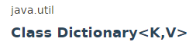
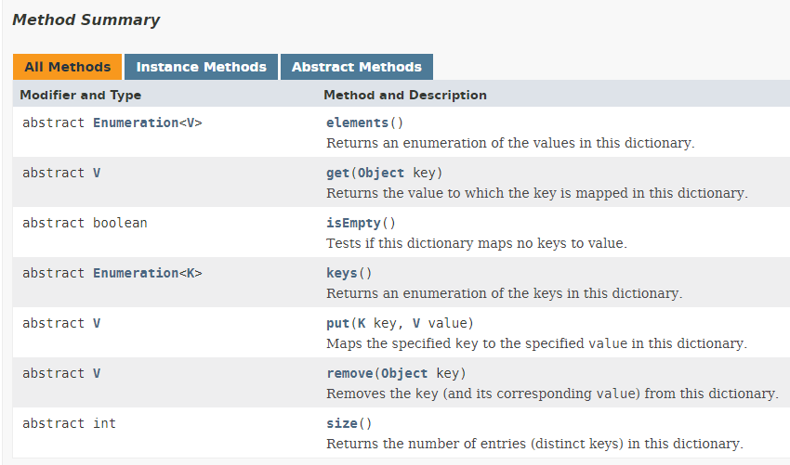
Java Class Library: The class Dictionary
Method headers for methods in Dictionary

Slide 56
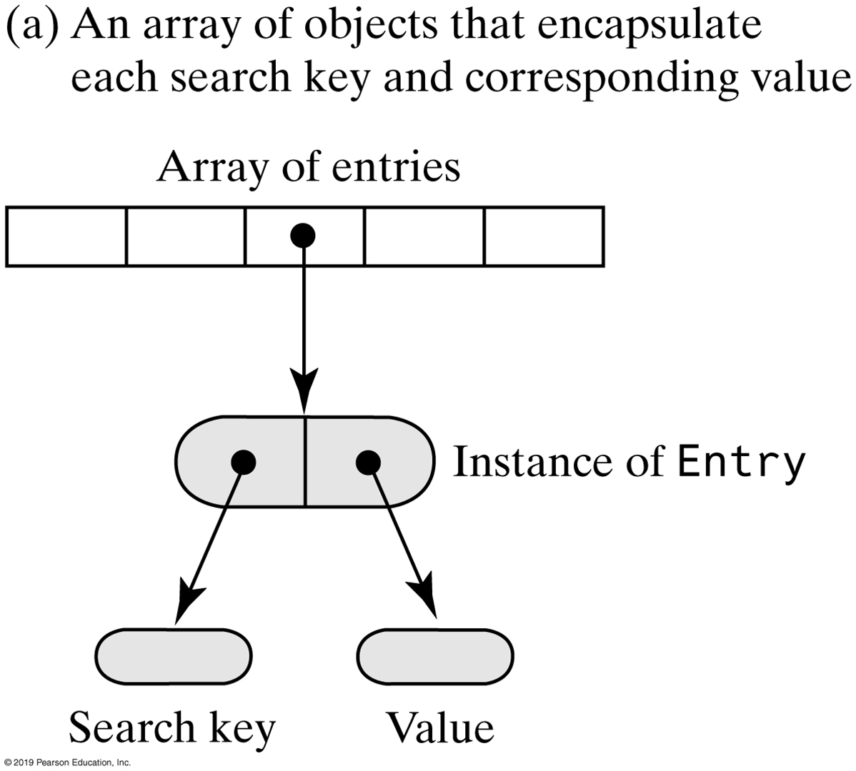
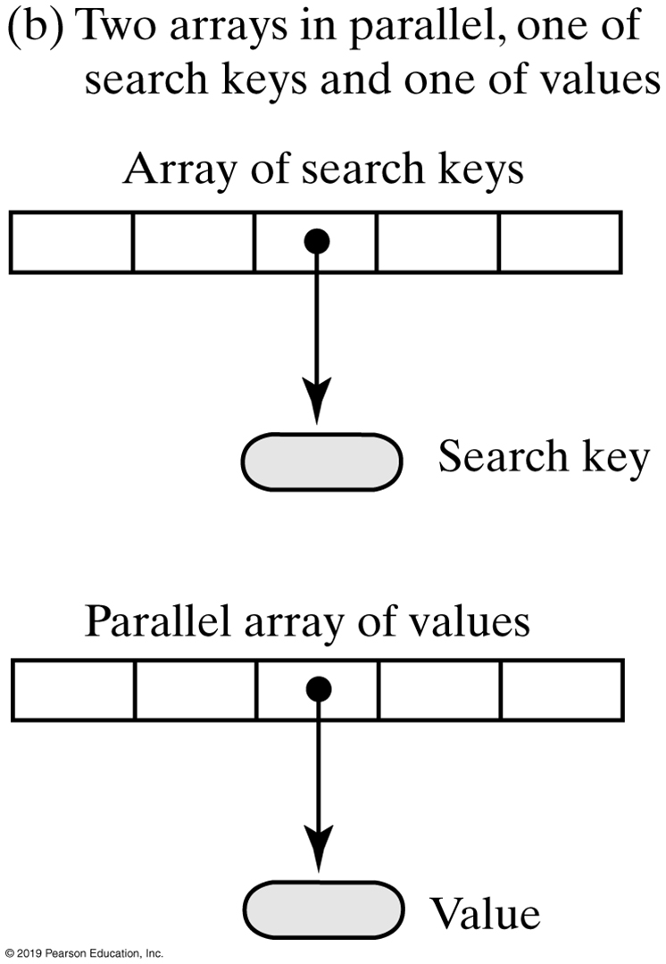
Array-Based Dictionaries
FIGURE 21-1 Two possible ways to use arrays to represent the entries in a dictionary

Slide 57
Array-Based Implementations (Part 1)
/** A class that implements the ADT dictionary by using a resizable array.
The dictionary is unsorted and has distinct search keys.
Search keys and associated values are not null. */
public class ArrayDictionary<K, V> implements DictionaryInterface<K, V>
{
private Entry<K, V>[] dictionary; // Array of unsorted entries
private int numberOfEntries;
vprivate boolean integrityOK = false;
private final static int DEFAULT_CAPACITY = 25;
private static final int MAX_CAPACITY = 10000;
public ArrayDictionary() {
this(DEFAULT_CAPACITY);
} // end default constructor
public ArrayDictionary(int initialCapacity)
{
checkCapacity(initialCapacity);
// The cast is safe because the new array contains null entries
@SuppressWarnings("unchecked")
Entry<K, V>[] tempDictionary = (Entry<K, V>[])new Entry[initialCapacity];
dictionary = tempDictionary;
numberOfEntries = 0;
integrityOK = true;
} // end constructor
/* < Implementations of methods in DictionaryInterface. > . . . */
LISTING 20-1 The class ArrayDictionary

Slide 58
Array-Based Implementations (Part 2)
private class Entry<K, V>
{
private K key;
private V value;
private Entry(K searchKey, V dataValue)
{
key = searchKey;
value = dataValue;
} // end constructor
private K getKey()
{
return key;
} // end getKey
private V getValue()
{
return value;
} // end getValue
private void setValue(V dataValue)
{
value = dataValue;
} // end setValue
} // end Entry
} // end ArrayDictionary
LISTING 21-1 The class ArrayDictionary and its private inner class Entry

Slide 59
Array-Based Implementations
Algorithm add(key, value)
// Adds a new key-value entry to the dictionary and returns null. If key already exists
// in the dictionary, returns the corresponding value and replaces it with value.
// key and value are not null.
result = null
Search the dictionary for an entry containing key
if (an entry containing key is found)
{
result = value currently associated with key
Replace key's associated value with value
}
else // Insert new entry
{
if (array is full)
Double size of array
Insert a new entry containing key and value after the last entry in the array
Increment the size of the dictionary
}
return result
Algorithm to add an entry.

Slide 60
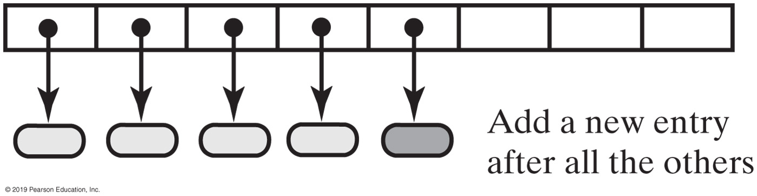
Unsorted Array-Based Implementations
FIGURE 21-2 Adding a new entry to an unsorted array-based dictionary

Slide 61
Unsorted Array-Based Implementations
public V add(K key, V value)
{
checkIntegrity();
if ((key == null) || (value == null))
throw new IllegalArgumentException("Cannot add null to this dictionary.");
else
{
V result = null;
int keyIndex = locateIndex(key);
if (keyIndex < numberOfEntries)
{
// Key found, return and replace entry's value
result = dictionary[keyIndex].getValue(); // Get old value
dictionary[keyIndex].setValue(value); // Replace value
}
else // Key not found; add new entry to dictionary
{
// Add at end of array
dictionary[numberOfEntries] = new Entry<>(key, value);
numberOfEntries++;
ensureCapacity(); // Ensure enough room for next add
} // end if
return result;
} // end if
} // end add
Implementation of the method add

Slide 62
Unsorted Array-Based Implementations
private int locateIndex(K key)
{
// Sequential search
int index = 0;
while ( (index < numberOfEntries) &&
!key.equals(dictionary[index].getKey()) )
index++;
return index;
}
Method locate used by add

Slide 63
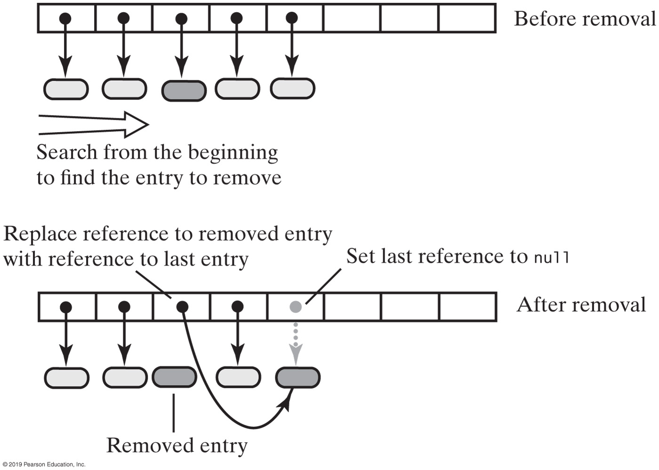
Unsorted Array-Based Implementations
FIGURE 21-3 Removing an entry from an unsorted array-based dictionary

Slide 64
Unsorted Array-Based Implementations
Algorithm remove(key)
// Removes an entry from the dictionary, given its search key, and returns its value.
// If no such entry exists in the dictionary, returns null.
result = null
Search the array for an entry containing key
if (an entry containing key is found in the array)
{
result = value currently associated with key
Replace the entry with the last entry in the array
Set array element containing last entry to null
Decrement the size of the dictionary
}
// Else result is null
return result
Algorithm to describe the remove operation.

Slide 65
Unsorted Array-Based Implementations
For this implementation, worst-case efficiencies of the operations are:
Addition: O(n)
Removal: O(n)
Retrieval: O(n)
Traversal: O(n)

Slide 66
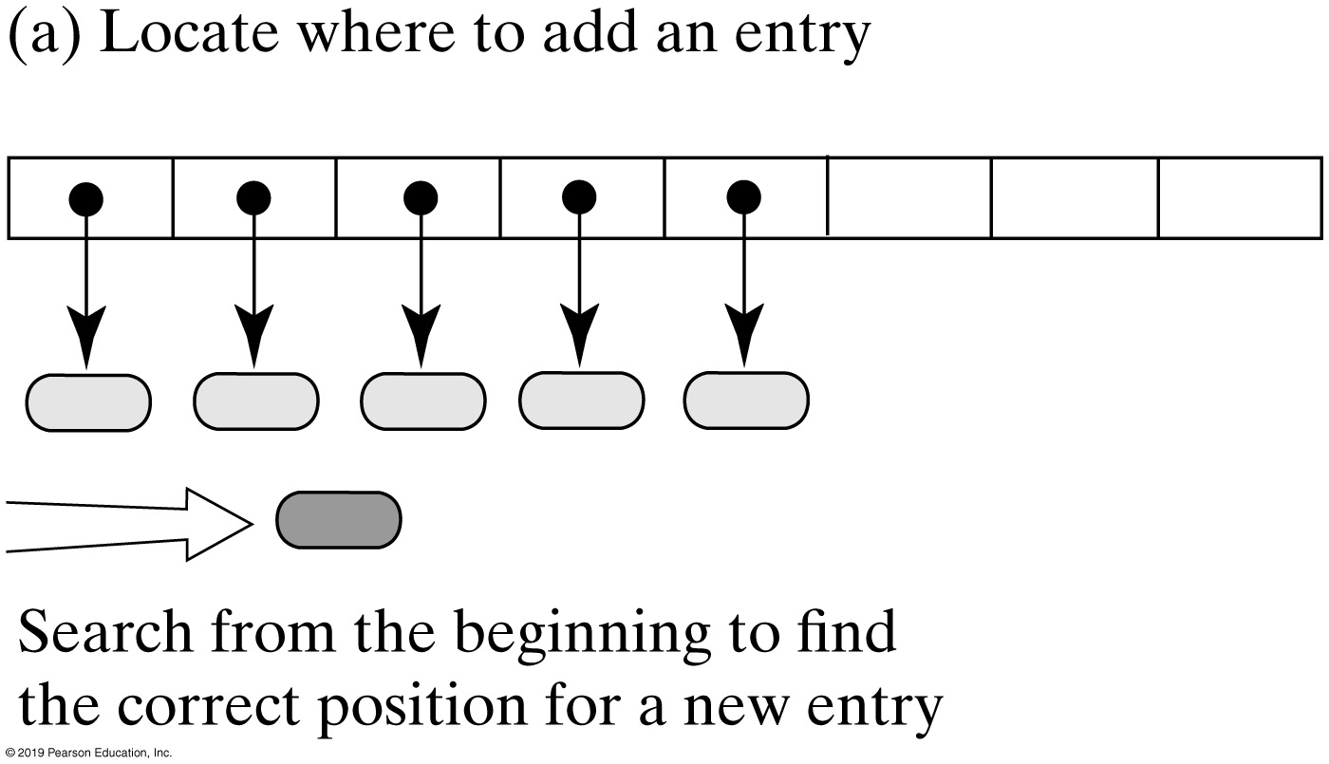
Sorted Array-Based Implementations
FIGURE 21-4a Adding an entry to a sorted array-based dictionary

Slide 67
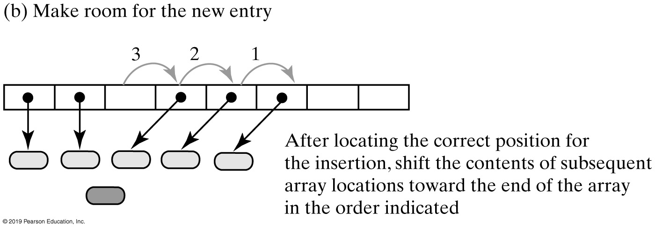
Sorted Array-Based Implementations
FIGURE 21-4b Adding an entry to a sorted array-based dictionary

Slide 68
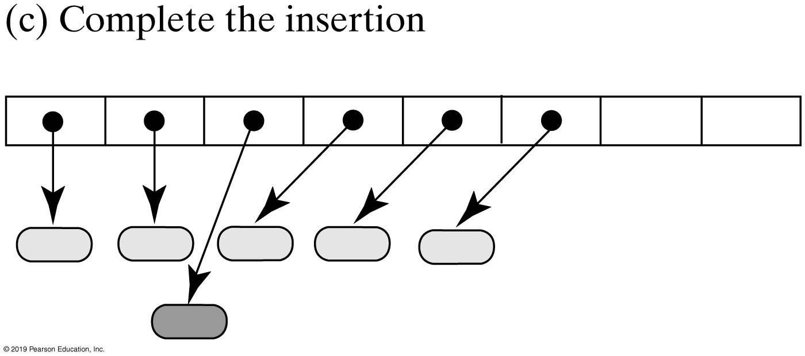
Sorted Array-Based Implementations
FIGURE 21-4c Adding an entry to a sorted array-based dictionary

Slide 69
Sorted Array-Based Dictionary
/** A class that implements the ADT dictionary by using a resizable array.
The dictionary is sorted and has distinct search keys. Search keys and
associated values are not null. */
public class SortedArrayDictionary<K extends Comparable<? super K>, V>
implements DictionaryInterface<K, V>
{
// Array of entries sorted by search key
private Entry<K, V>[] dictionary;
private int numberOfEntries;
private boolean integrityOK = false;
private final static int DEFAULT_CAPACITY = 25;
private static final int MAX_CAPACITY = 10000;
/* < Constructors analogous to those in Listing 21-1.
. . .
Implementations of methods in DictionaryInterface.
. . .
The private class Entry, as shown in Listing 21-1.
. . .
*/
} // end SortedArrayDictionary
LISTING 21-2 An outline of the class SortedArrayDictionary

Slide 70
Sorted Array-Based Dictionary
Algorithm add(key, value)
// Adds a new key-value entry to the dictionary and returns null. If key already exists
// in the dictionary, returns the corresponding value and replaces it with value.
If either key or value is null, throw an exception
result = null
Search the array until you either find an entry containing key or locate the point where it should be
if (an entry containing key is found in the array)
{
result = value currently associated with key
Replace key’s associated value with value
}
else // Insert new entry
{
Make room in the array for a new entry at the index indicated by the previous search
Insert a new entry containing key and value into the vacated location of the array
Increment the size of the dictionary
if (array is full)
Double size of array
}
return result
Algorithm for adding an entry

Slide 71
Sorted Array-Based Dictionary
public V add(K key, V value)
{
checkIntegrity();
if ((key == null) || (value == null))
throw new IllegalArgumentException("Cannot add null to this dictionary.");
else
{
V result = null;
int keyIndex = locateIndex(key);
if ( (keyIndex < numberOfEntries) &&
key.equals(dictionary[keyIndex].getKey()) )
{
// Key found, return and replace entry's value
result = dictionary[keyIndex].getValue(); // Get old value
dictionary[keyIndex].setValue(value); // Replace value
}
else // Key not found; add new entry to dictionary
{
makeRoom(keyIndex); // Make room for new entry
dictionary[keyIndex] = new Entry<>(key, value); // Insert new entry in array
numberOfEntries++;
ensureCapacity(); // Ensure enough room for next add
} // end if
return result;
} // end if
} // end add
Implementation of method add.

Slide 72
Sorted Array-Based Dictionary
// Returns the index of either the entry that contains key or
// the location that should contain key, if no such entry exists.
private int locateIndex(K key)
{
// Search until you either find an entry containing key or
// pass the point where it should be
int index = 0;
while ( (index < numberOfEntries) &&
key.compareTo(dictionary[index].getKey()) > 0 )
{
index++;
} // end while
return index;
} // end locateIndex
Definition of the private method locateIndex

Slide 73
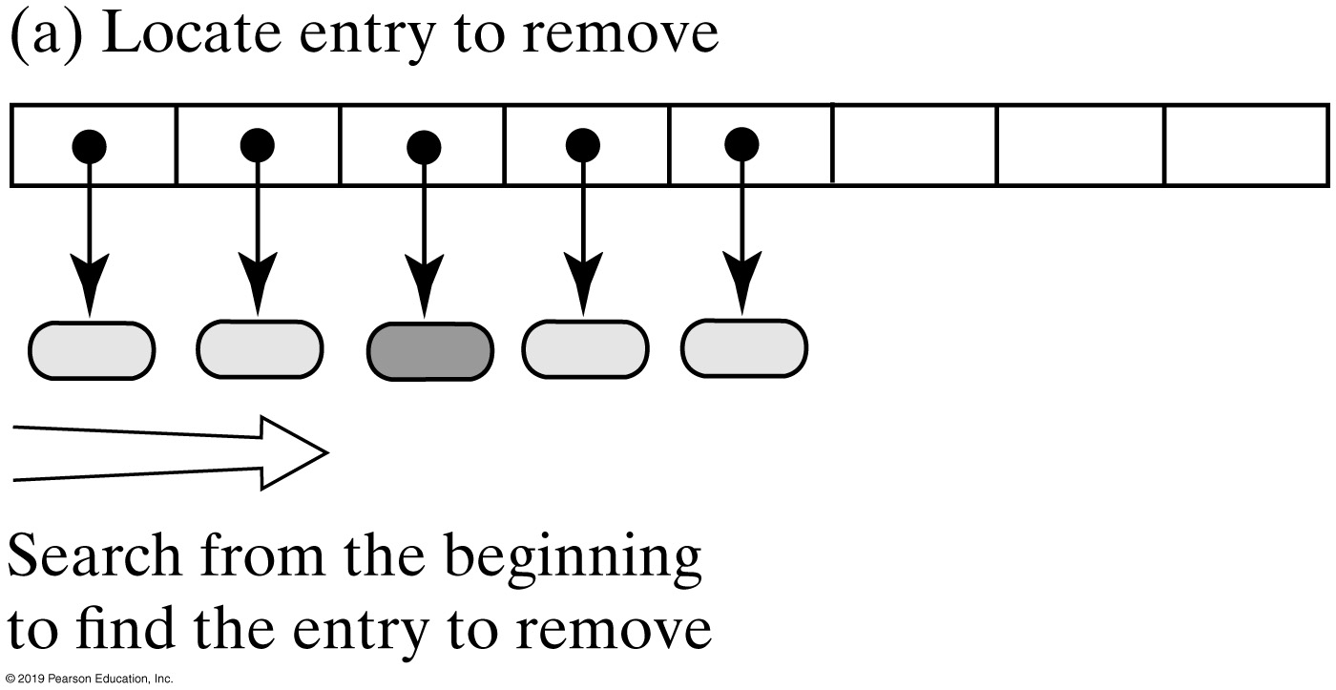
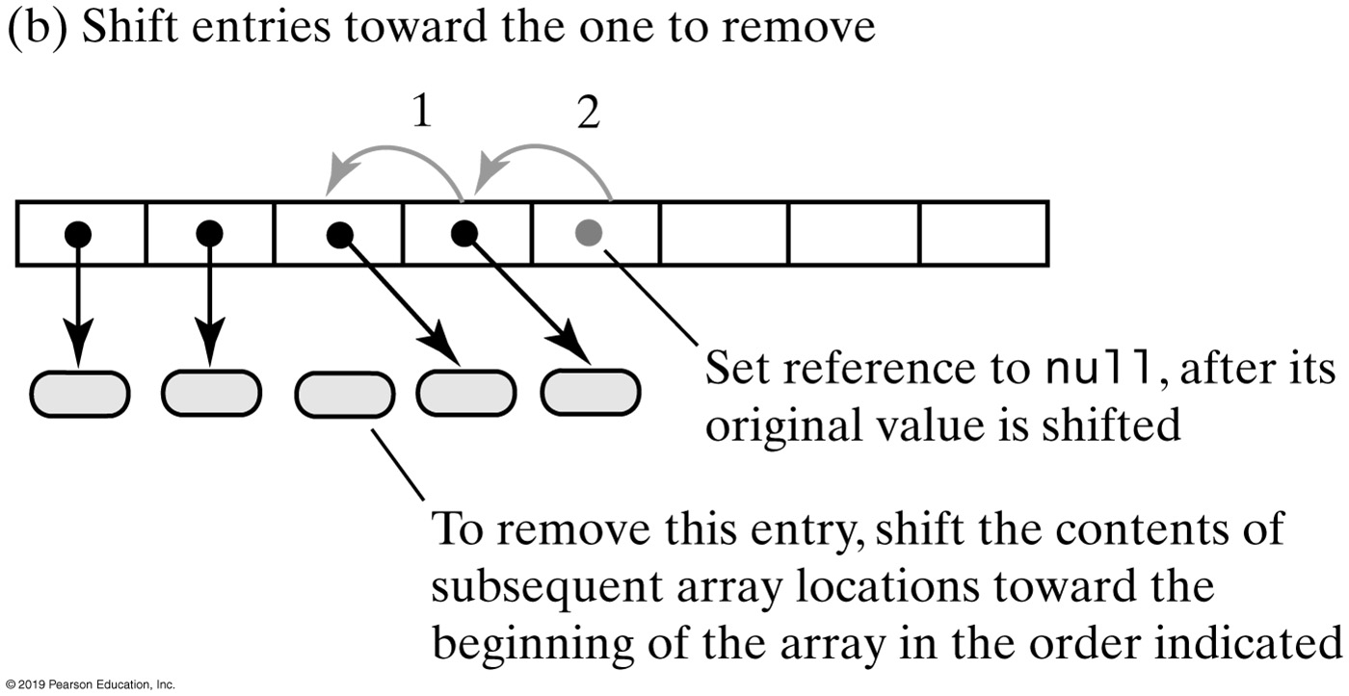
Sorted Array-Based Dictionary
FIGURE 21-5 Removing an entry from a sorted array-based dictionary

Slide 74
Sorted Array-Based Dictionary
Algorithm remove(key)
// Removes an entry from the dictionary, given its search key, and returns its value.
// If no such entry exists in the dictionary, returns null.
result = null
Search the array for an entry containing key
if (an entry containing key is found in the array)
{
result = value currently associated with key
Shift any entries that are after the located one to the next lower position in the array
Set array element that had contained last entry to null
Decrement the size of the dictionary
}
return result
Algorithm that describes the remove operation

Slide 75
Sorted Array-Based Dictionary
Efficiency of sorted array-based dictionary.
When locateIndex uses a binary search in the sorted array-based implementation, the worst-case efficiencies are:
Addition: O(n)
Removal: O(n)
Retrieval: O(log n)
Traversal: O(n)

Slide 76
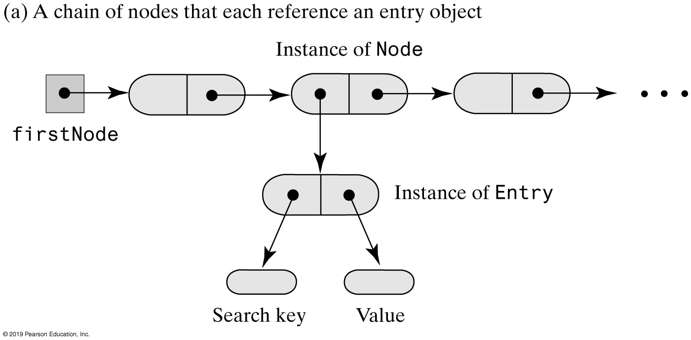
Linked Dictionary Implementations
FIGURE 21-6a Representing the entries in a dictionary

Slide 77
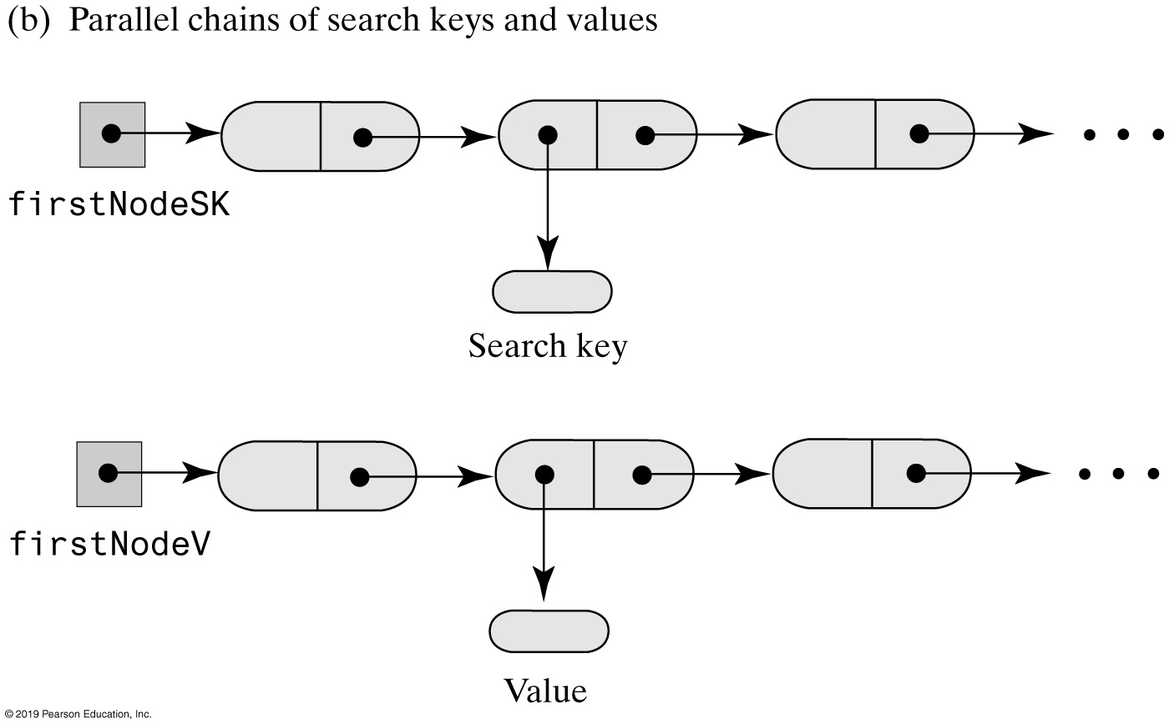
Linked Dictionary Implementations
FIGURE 21-6b Representing the entries in a dictionary

Slide 78
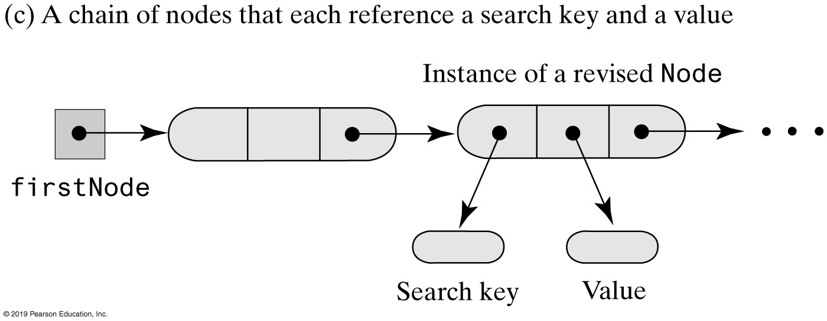
Linked Dictionary Implementations
FIGURE 21-6c Representing the entries in a dictionary

Slide 79
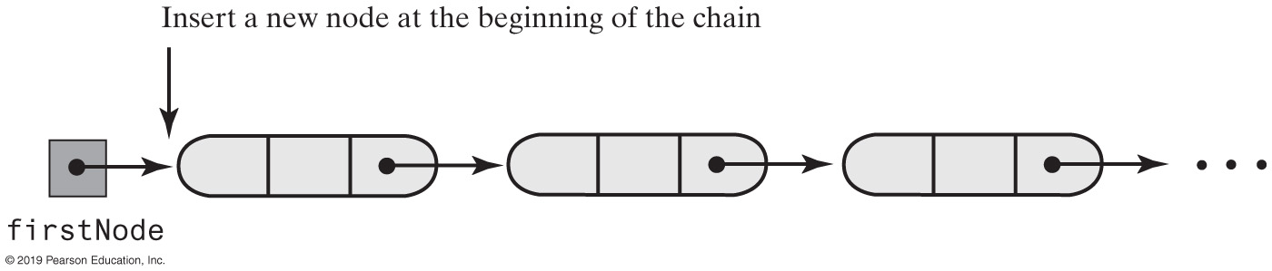
Linked Dictionary Implementations
FIGURE 21-7 Adding to an unsorted linked dictionary

Slide 80
An Unsorted Linked Dictionary
Efficiency of an unsorted linked dictionary:
The worst-case efficiencies of the operations.
Addition: O(n)
Removal: O(n)
Retrieval: O(n)
Traversal: O(n)

Slide 81
Sorted Linked Dictionary
Algorithm add(key, value)
// Adds a new key-value entry to the dictionary and returns null. If key already exists
// in the dictionary, returns the corresponding value and replaces that value with value.
If either key or value is null, throw an exception
result = null
Search the chain until either you find a node containing key or you pass the point where it should be
if (a node containing key is found in the chain)
{
result = value currently associated with key
Replace key’s associated value with value
}
else
{
Allocate a new node containing key and value
if (the chain is empty or the new entry belongs at the beginning of the chain)
Add the new node to the beginning of the chain
else
Insert the new node before the last node that was examined during the search Increment the size of the dictionary
}
return result
Algorithm for adding new entry to sorted linked dictionary

Slide 82
Sorted Linked Dictionary (Part 1)
/** A class that implements the ADT dictionary by using a chain of linked nodes.
The dictionary is sorted and has distinct search keys.
Search keys and associated values are not null. */
public class SortedLinkedDictionary<K extends Comparable<? super K>, V>
implements DictionaryInterface<K, V>
{
private Node firstNode; // Reference to first node of chain
private int numberOfEntries;
public SortedLinkedDictionary()
{
initializeDataFields();
} // end default constructor
private class Node
{
private K key;
private V value;
private Node next;
/* Constructors and the methods getKey, getValue, setValue, getNextNode,
and setNextNode are here. There is no setKey.
. . . */
} // end Node
} // end SortedLinkedDictionary
LISTING 21-5 The class SortedLinkedDictionary

Slide 83
Sorted Linked Dictionary (Part 2)
public V add(K key, V value)
{
V result = null;
if ((key == null) || (value == null))
throw new IllegalArgumentException("Cannot add null to a dictionary.");
else
{
// Search chain until you either find a node containing key
// or locate where it should be
Node currentNode = firstNode;
Node nodeBefore = null;
while ( (currentNode != null) && (key.compareTo(currentNode.getKey()) > 0))
{
nodeBefore = currentNode;
currentNode = currentNode.getNextNode();
} // end while
if ( (currentNode != null) && key.equals(currentNode.getKey()) )
{
// Key in dictionary; replace corresponding value
result = currentNode.getValue(); // Get old value
currentNode.setValue(value); // Replace value
}
else // Key not in dictionary; add new node in proper order
LISTING 21-5 Method add of class SortedLinkedDictionary

Slide 84
Sorted Linked Dictionary (Part 3)
{
// Assertion: key and value are not null
Node newNode = new Node(key, value); // Create new node
if (nodeBefore == null)
{ // Add at beginning (includes empty chain)
newNode.setNextNode(firstNode);
firstNode = newNode;
}
else // Add elsewhere in non-empty chain
{
newNode.setNextNode(currentNode); // currentNode is after new node
nodeBefore.setNextNode(newNode); // nodeBefore is before new node
} // end if
numberOfEntries++; // Increase length for both cases
} // end if
} // end if
return result;
} // end add
LISTING 21-5 Method add of class SortedLinkedDictionary

Slide 85
Sorted Linked Dictionary
Efficiency of a sorted linked dictionary:
The worst-case efficiencies of the operations.
Addition: O(n)
Removal: O(n)
Retrieval: O(n)
Traversal: O(n)

Slide 86
Implementation Comparison
Operation | Array-based Unsorted | Array-based Sorted | Linked Unsorted | Linked Sorted
Addition | O(n) | O(n) | O(n) | O(n)
Removal | O(n) | O(n) | O(n) | O(n)
Retrieval | O(n) | O(log n) | O(n) | O(n)
Traversal | O(n) | O(n) | O(n) | O(n)

